Slide 1
Threat Modeling and Attack Simulations for Vehicles with securiCAD
Per Eliasson – Head of Development foreseeti
DEx Conference October 2019

Slide 2

Agenda
vehicleLang in securiCAD Enterprise
vehicleLang
Meta Attack Language

Slide 3
securiCAD Enterprise
Web-based application for threat modeling, attack simulations and analysis
Model editing
Proactive what-if analysis
Collaboration – multi-user and projects
Now with experimental support for Meta Attack Language and vehicleLang - Demo
https://www.foreseeti.com/securicad-enterprise/

Slide 4
vehicleLang
Developed by Sotirios Katsikeas (sotkat@kth.se) as a Master’s Thesis at foreseeti
Assessed by Nedo Skobalj in a Master’s Thesis at Scania
Based on the Meta Attack Language platform
Assets, attack steps and associations tailored to vehicle on-board systems
Available on GitHub under Apache 2.0 license
https://mal-lang.org/

Slide 5
Meta Attack Language toolchain
MAL compiler on GitHub
MAL maintainers
MAL language syntax specification
vehicleLang Language specification
MAL compiler
Java language source
vehicleLang JAR
Modeling test programs
Domain specific threat modeling language designers/maintainers
Vehicle threat model (.sCAD)
securiCAD
Model mgmt
Simulation
Reporting
Reports / actionable insights
Threat modellers / Analysts

Slide 6
Meta Attack Language
A language to design threat modeling and attack simulation systems/languages
https://mal-lang.org/
Available on GitHub under Apache 2.0 license
Open source project
Allows for creation of domain specific threat modeling languages/systems:
  Vehicles (ThreatMove)
  Amazon AWS Cloud (foreseeti, KTH)
  Microsoft Azure (foreseeti)
  Electrical power systems/OT (EU H2020 EnergyShield)
  KTH research
Gaining interest – UK/Germany, SCADA/OT

Slide 7
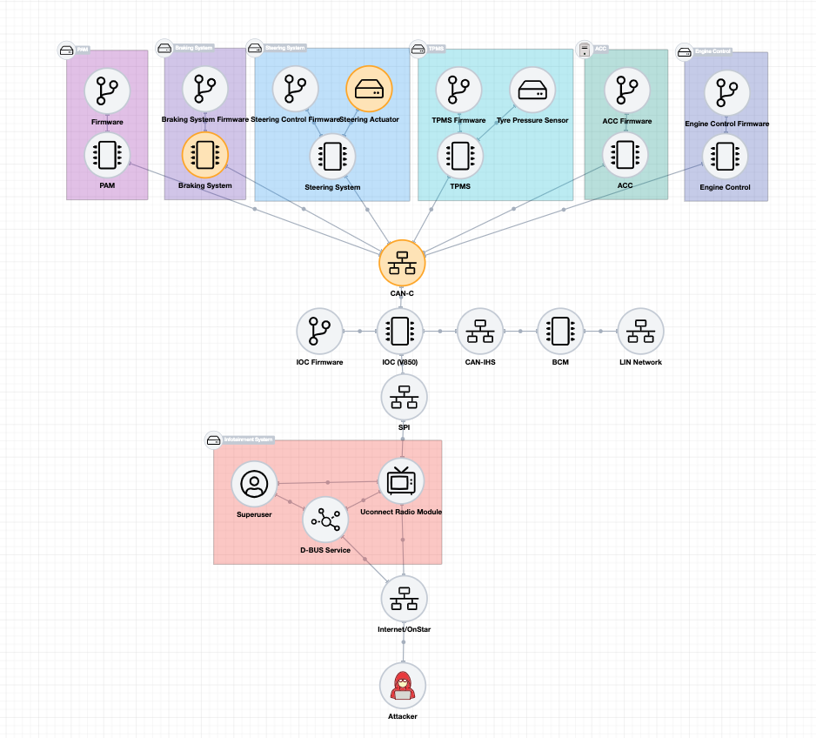
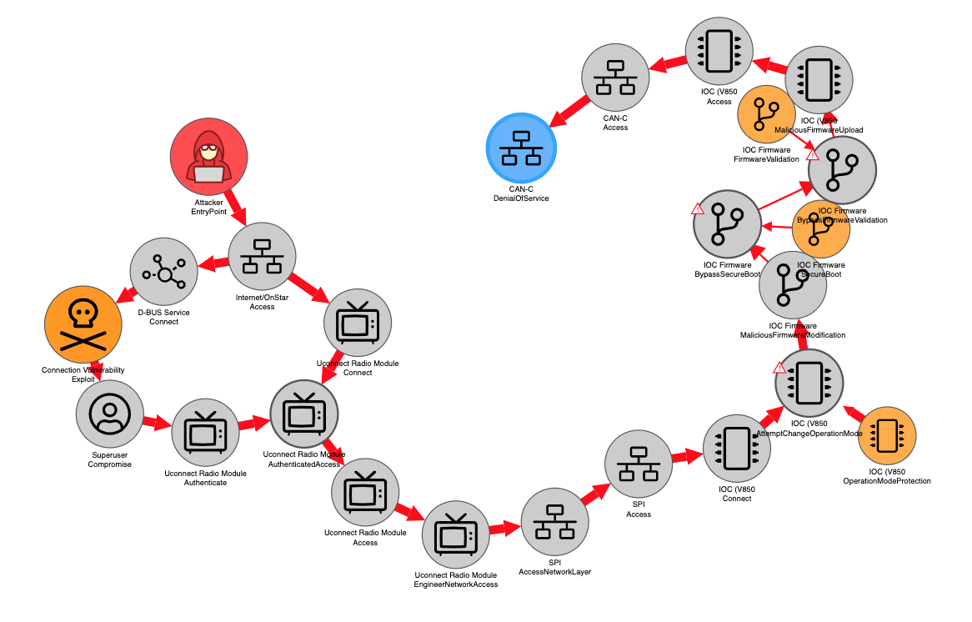
Live demo of vehicleLang in securiCAD Enterprise
From Cherokee Threat model
. . .
To Critical Attack Path

