Slide 1
HoliSec in Focus: Results, perspective and impact
Mahboobeh Daftari
October 10, 2019. Time 09:15 – 09:45
Mahboobeh.daftari@volvo.com
Notes:
I am talking for everyone that has worked within the project.

Slide 2
Presentation Outline
Project objective
  Scope / Activities
  Deliverables / Achievements

Slide 3
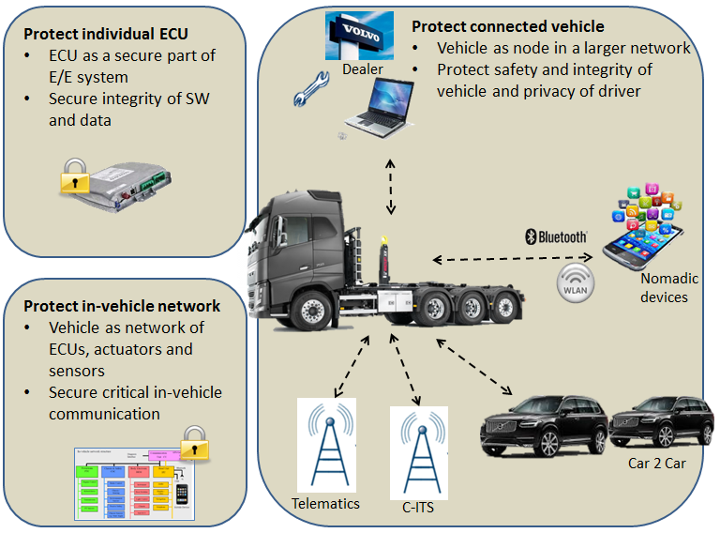
HoliSec (April 2016 - December 2019)
Swedish national public funded research project
Volvo Group Coordinator
Budget ~ 40.6 MSEK
How to establish ”TRUST”?
The objective has been to holistically address security concerns in the complete automotive chain from concept, design, development, integration, testing, verification & validation and operational phases.

Slide 4
Main Activities
Security & privacy requirements in vehicle connectivity
Cryptographic support and key management
Security mechanisms for connected vehicle
  Secure vehicle diagnostics
  Secure communication
  Interplay between safety, security and privacy
  Intrusion detection
Secure development & governance
  Secure software and system design
  Secure software verification and validation
Demonstration and dissemination
Notes:
. To identify and understand requirements from the industry
. To solve challenges like how should two systems of mixed security level communicate. Also, AUTOSAR SecureOnboardCommunication concept leaves key management open to be solved by the OEM
. For use cases
Secure vehicle diagnostics, one of the most common attack vectors of vehicle
Analysis of mechanisms for both external connections towards vehicle and internal vehicle connections (the description, security level they are suitable for, necessary hardware requirements, their impact on safety and realtime performance of vehicle, etc.)
security mechanisms evaluated from safety and security perspective through fault and attack injection experiments
. Focus on security by desing, i.e. Looking into a robust design for automotive software against security and privacy threats
identify and deveop methods and tools for validation and verification of automotive secure software development

Slide 5
Projetc Execution – WPs (2016-2019)
WP1: Security & privacy requirements in vehicle connectivity
  SOTA
  Needs & Requirements
WP2: Cryptographic support and key management
  Investigate cryptography and key management solutions
  Key management lifecycle
  Investigate cryptography solutions and key management algorithms from other domains
WP3: Security mechanisms for connected vehicle
  Secure vehicle diagnostics
  Secure communication
  Interplay between safety, security and privacy
  Intrusion detection
WP4: Secure development & governance
  Secure software and system design
  Secure software verification and validation
WP5: Demonstration and dissemination

Slide 6
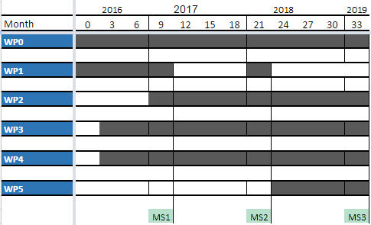
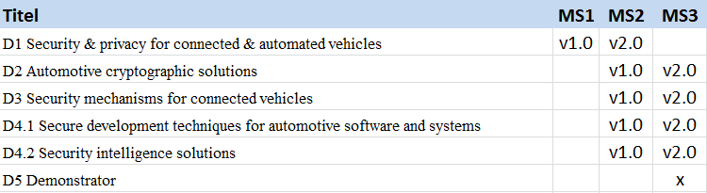
Time Plan

Slide 7
Results from WP1 - Security & Privacy Requirements in Vehicle Connectivity
1. Needs and requirements for security and privacy as a base for the other work packages within the HoliSec project
2. HoliSec state of the art
Notes:
1.The purpose of this document is to explore the security and privacy needs and requirements in order to serve as a base for the other work packages within the HoliSec project. The scope has been to investigate the needs and requirements for:
increased levels of connectivity and automation in vehicles
access methods with both permanent and temporary access to the vehicle and its parts
data sharing and big data according to user consent in collaborative ITS, predictive maintenance and product improvement

Slide 8
Results from WP2 - Cryptographic Support and Key Management
BusGoat - a deliberately vulnerable ECU developed to serve different purposes
  SUFFI (training program funded by Vinnova)
  Bug Bounty
Lack of message integrity on the CAN bus
  A proposal to secure communication including asymmetric encryption for key exchange, symmetric encryption for effective data protection, aggregated message authentication, and key derivation and freshness

Slide 9
Results from WP3 – Secure Vehicle Diagnostics
A PKI solution to establish trust between a diagnostic tester and ECUs.
A diagnostic connection needs to be established which maintains the authenticity of the user and the diagnostic tester, and the integrity of the data when it is transmitted.
Notes:
On the diagnostics part...

Slide 10
Results from WP3 – Secure Communication
1. An evaluation of promising CAN message authentication solutions.
2. Discussion about the possibilities of memory exploitation techniques on resource constrained automotive systems.
3. Recommendations to improve vehicular security throughout the entire software development lifecycle based on an automotive use case.
4. Identification of security issues in the automotive domain based on a survey for automotive security experts.
5. A study on how security levels should be structured for the automotive domain.
6. A mapping between automotive security levels and required mandatory security mechanisms and design rules.
7. An analysis of AUTOSAR SecOC Profile 3, a method to provide freshness to authenticated messages, and a proposal on how to improve it.
8. A preliminary assessment of the security implications of replacing 802.11p with cellular V2X.
Notes:
IEEE 802.11p is an approved amendment to the IEEE 802.11 standard to add wireless access in vehicular environments (WAVE), a vehicular communication system
It defines enhancements to 802.11 (the basis of products marketed as Wi-Fi) required to support Intelligent Transportation Systems (ITS) applications
IEEE 802.11 is the set of technical guidelines for implementing Wi-Fi

Slide 11
WP3 - Secure Communication
Eight publications:
1. N. Nowdehi, A. Lautenbach, and T. Olovsson, “In-vehicle can message authentication: An evaluation based on industrial criteria”, in 2017 IEEE 86th Vehicular Technology Conference (VTC-Fall), Sep. 2017, pp. 1–7. DOI: 10.1109/VTCFall.2017.8288327.
2. A. Lautenbach, M. Almgren, and T. Olovsson, “What the stack? on memory exploitation and protection in resource constrained automotive systems”, in Critical Information Infrastructures Security, G. D’Agostino and A. Scala, Eds., Cham: Springer International Publishing, 2018, pp. 185–193, ISBN: 978-3-319-99843-5
3. T. Rosenstatter and T. Olovsson, “Open problems when mapping automotive security levels to system requirements”, in Proceedings of the 4th International Conference on Vehicle Technology and Intelligent Transport Systems - Volume 1: VEHITS, INSTICC, SciTePress, 2018, pp. 251–260, ISBN: 978-989-758-293-6. DOI: 10.5220/0006665302510260.
4. T. Rosenstatter and T. Olovsson, “Towards a standardized mapping from automotive security levels to security mechanisms”, in 2018 21st International Conference on Intelligent Transportation Systems (ITSC), Nov. 2018, pp. 1501–1507. DOI: 10.1109/ ITSC.2018.8569679.
5. A. Lautenbach, M. Almgren and T. Olovsson, “Understanding Common Automotive Security Issues and Their Implications” presented at International Workshop on Interplay of Security, Safety and System/Software Architecture 2018
6. A. Lautenbach, N. Nowdehi, T. Olovsson and R. Zaragatzky, "A Preliminary Security Assessment of 5G V2X," 2019 IEEE 89th Vehicular Technology Conference (VTC2019-Spring), Kuala Lumpur, Malaysia, 2019, pp. 1-7.
doi: 10.1109/VTCSpring.2019.8746547
7. T. Rosenstatter, C. Sandberg and T. Olovsson, “Extending AUTOSAR’s Counter-based Solution for Freshness of Authenticated Messages in Vehicles” accepted at ” 24th IEEE Pacific Rim International Symposium on Dependable Computing (PRDC 2019)”.

Slide 12
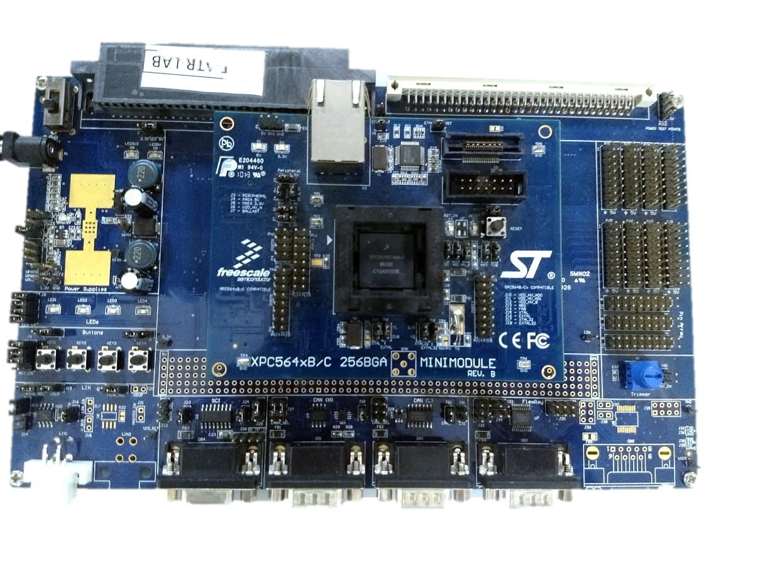
Results from WP3 - Secure Communication
Evaluation of the AUTOSAR SecOC module:
Message Tampering – check if the slave ECU detects the tampered message
Re-synchronization – check if the slave ECU re-synchronises immediately after a wake-up from sleep
Performance Measurement – measure the minimum latency of message been transferred from master to slave ECU with and without security
Receiver 1
Sender
CAN/Ethernet
Receiver 2
MPC5646C Evaluation board

Slide 13
Results from WP3 - Interplay between Safety, Security and Privacy
Analysis of the most common security mechanisms listed in the IEC 62443 standard, SESAMO, OWASP, and NIST SP 800-53.
focussed on
Dependability attributes reliability, safety, maintainability, availability, integrity and confidentiality
And security attributes in HEAVENS; authenticity, authorization, non-repudiation, freshness and privacy
Result:
Safety:
  12 mechanisms may have positive effects on safety
  2 mechanisms may have negative effect on safety: authentication control, access control
Privacy:
  2 mechanisms target privacy: encryption, VPN
  2 mechanisms have negligible effect on privacy: device authentication, signatures
Notes:
The interplay between safety, security and privacy was investigated through an evaluation of the most common security mechanisms listed in the starndars
The applicability for safety, security and privacy was investigated by focussing the evaluation on the dependability attributes

Slide 14
Results from WP3 - Log and Intrusion Detection
Step1 (identifying the needs and challenges)
The needs, challenges and requirements for developing Intrusion Detection System (IDS) and logging in In-Vehicle Networks (IVNs).
Step 2 (Implementation of a light-weight IDS)
Design and implement a lightweight in-vehicle IDS with a combination of misuse and behavioral detection algorithms. The IDS can detect:
  arbitrary message injection
  attacks in which message properties deviate from the original specification.

Slide 15
Results from WP3 - Log and Intrusion Detection, Cont.
Step 3 (CASAD: CAN-Aware Stealthy Attack Detection)
Introduce a specification-agnostic novel stealthy attack detection mechanism
Investigation of logging needs
Security events that can be logged are limited in most ECUs
Recording and collecting security events is an important part of a robust security posture
Notes:
Introduce a specification-agnostic novel stealthy attack detection mechanism
overcomes the limitations of the existing work
fast, lightweight, and system-agnostic approach
learns the normal behavior of IVN dynamics from historical data
detects deviations by continuously monitoring IVN traffic
Implemented on a low-end hardware and demonstrated on a 2018 Volvo XC60 test vehicle
can detect stealthy attacks on IVNs in addition to the classical attacks

Slide 16
Results from WP4 - Secure Software and System Design
Goal
definition of security-oriented design models that:
1. reflect security goals
2. support the analysis of security properties
Contribution
1. eSTRIDE: aims at improving the efficiency
2. SecDFD: an automated tool for the analysis of security issues in flow-oriented, asset-centric models
Achievements
defining a family of notations that extend Data Flow Diagrams for the purpose of security and privacy: eDFD, SecDFD, PriDFD
Notes:
The key contribution of this task has been the creation of advanced analysis techniques for the identification of security threats
Achievement: The goal was achieved by defining an famiy of ...
These notations allow the designers to describe the relevant security objectives for each information asset and to record the security assumptions that have been made.

Slide 17
Results from WP4 - Secure Software and System Design
Publications:
Katja Tuma, Riccardo Scandariato, Mathias Widman, Christian Sandberg, Towards security threats that matter, Workshop On The Security Of Industrial Control Systems & Of Cyber-Physical Systems (CyberICPS), 2017
Katja Tuma, Musard Balliu, Riccardo Scandariato, Flaws in Flows: Unveiling Design Flaws via Information Flow Analysis, International Conference on Software Architecture (ICSA), 2019
Thibaud Antignac, Riccardo Scandariato, Gerardo Schneider, Privacy Compliance via Model Transformations, International Workshop on Privacy Engineering (IWPE), 2018
Katja Tuma, Gul Calikli, Riccardo Scandariato, Threat analysis of software systems: A systematic literature review, Journal of Systems and Software, Volume 144, Pages 275-294, 2018
Katja Tuma, Riccardo Scandariato, Two Architectural Threat Analysis Techniques Compared, European Conference on Software Architecture (ECSA), 2018
Sven Peldszus, Katja Tuma, Daniel Strüber, Jan Jürjens, Riccardo Scandariato, Secure Data-Flow Compliance Checks between Models and Code based on Automated Mappings, International Conference on Model Driven Engineering Languages and Systems (MODELS), 2019
Laurens Sion, Katja Tuma, Riccardo Scandariato, Koen Yskout, Wouter Joosen, Towards Automated Security Design Flaw Detection, International Workshop on Software Security from Design to Deployment (SEAD), 2019
Katja Tuma, Daniel Hosseini, Kyriakos Malamas, Riccardo Scandariato, Inspection Guidelines to Identify Security Design Flaws, International Workshop on Designing and Measuring CyberSecurity in Software Architecture (DeMeSSA), 2019

Slide 18
Results from WP4 - Secure Software Verification & Validation
Study verification and validation methods: ISO/SAE 21434, IEC 62443, ISO/IEC 27005:2018
Attack injection framework
Fault injection has been successfully used to evaluate system safety
It maps well into security testing frameworks: Fuzz testing, Vulnerability testing, Penetration testing
  MODIFI: Model-Implemented Fault- and Attack Injection Tool
  Experimental results
  Some of the cybersecurity attack models could be mapped to fault-models commonly-used in the dependability domain
  Suggestion
  Safety and security analysis of computer systems should be done by a mixed group of safety and security experts
Notes:
Fault Injection: Common approach for evaluating system safety, Injects artificial faults in systems
How effective is it to use fault injection to inject security attacks?
To what extent can security attacks influence system safety?
Attacks may be considered as a special type of faults
Publication
B. Sangchoolie, P. Folkesson and J. Vinter, “A Study of the Interplay Between Safety and Security Using Model-Implemented Fault Injection,” 2018 14th European Dependable Computing Conference (EDCC), Iasi Romania, 2018.

Slide 19
Results from WP4 – Bug Bounty
Bug bounty was initially planned, and stopped due to (too) large complexity and organizational constraints (aligning all needed resources was found difficult).
Results of the work that was conducted before it was cancelled:
Interview study on enablers and barriers for bug bounties in vehicle industry
Systematic review of available literature
Equipment to be used for selection of bug hunters - BusGoat was developed. An evolved version of it was later used in SUFFI project to give education of automotive cybersecurity

Slide 20
WP4 – Bug Bounty
Three scientific articles:
Paper 1, accepted:
“Bug Bounty Programs - A Mapping Study”
Euromicro conference on Software Engineering and Advanced Applications 2019
Ana Magazinius, Niklas Mellegård, Linda Olsson
Paper 2, accepted:
"What we Know About Bug Bounty Programs - an Exploratory Systematic Mapping Study”
ESORICS 2019, European Symposium on Research in Computer Security
Ana Magazinius, Niklas Mellegård, Linda Olsson
Paper 3, study ongoing:
“Automotive Bug Bounties - Opportunities, Enablers and Barriers”
Ana Magazinius, Niklas Mellegård

Slide 21
WP5 - Demonstration & Dissemination
Project dissemination site (AutoSec)
Seminars & workshops (HoliSec seminars, SUFFI)
External conferences & Events (DeX seminars)
Demonstrators
Internal demonstration and dissemination at each participating partner
Collaboration with
  C2C Communication Consortium
  AUTOSAR
  Cyber Security Vehicle ICT

Slide 22

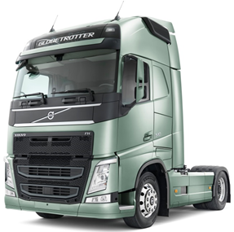


?
?
HoliSec
Holistic Approach to Improve Data Security
Q & A

Slide 23
HoliSec
Holistic Approach to Improve Data Security
Thank you for your attention!

