Slide 1


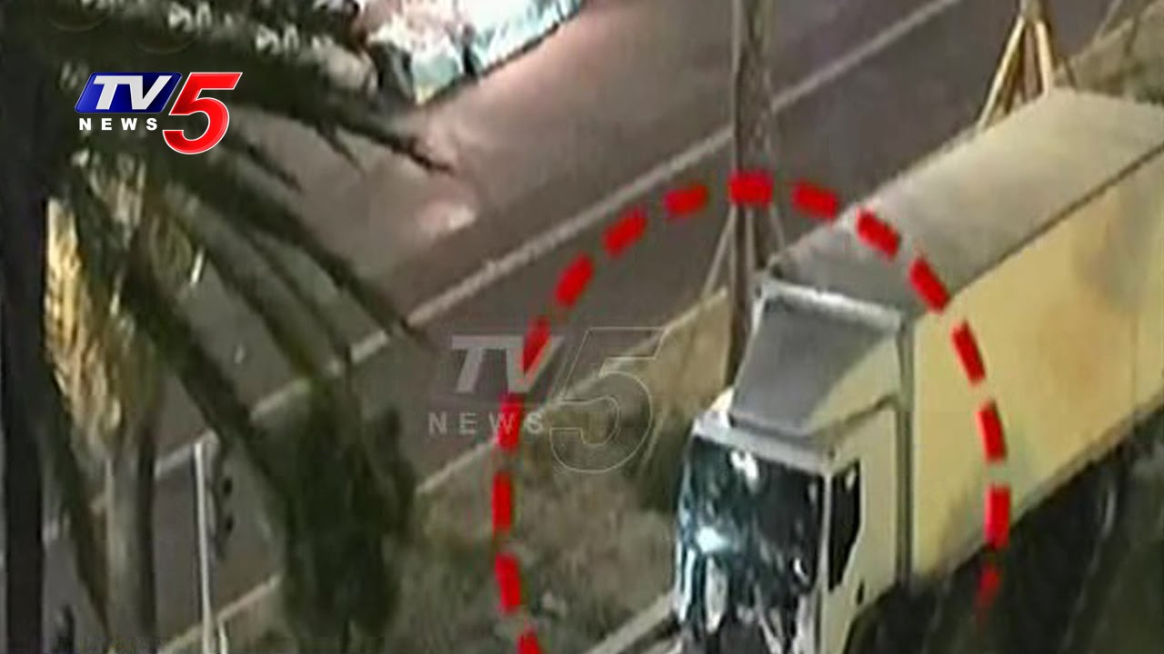

Slide 2


“…….These attacks have had a common denominator: transport systems have been used either as a means or as a target.”

Slide 3
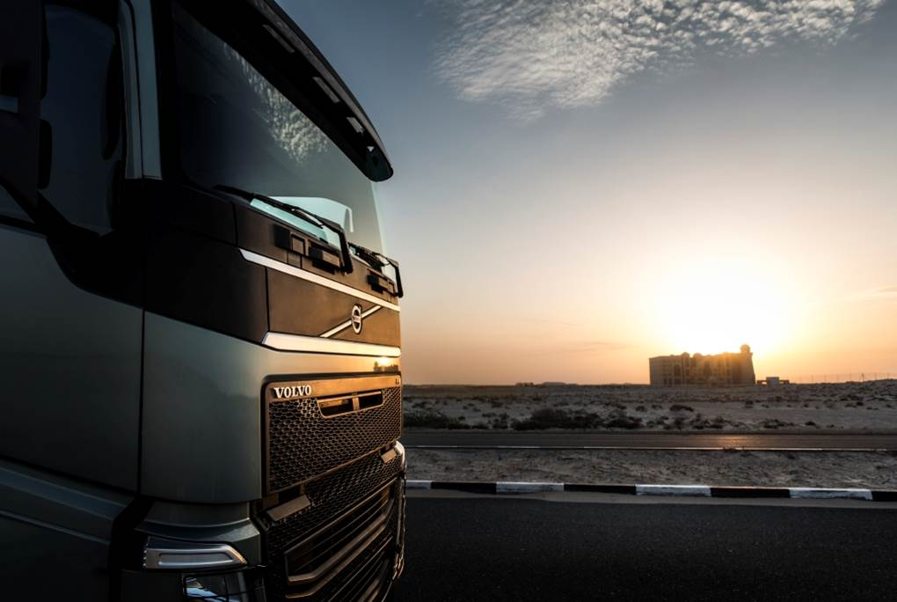
Cybersecurity Challenges in the “Commercial” Vehicle Industry
Mafijul Islam
March 27, 2018
Contributors: Christian Sandberg, Andreas Bokesand

Slide 4
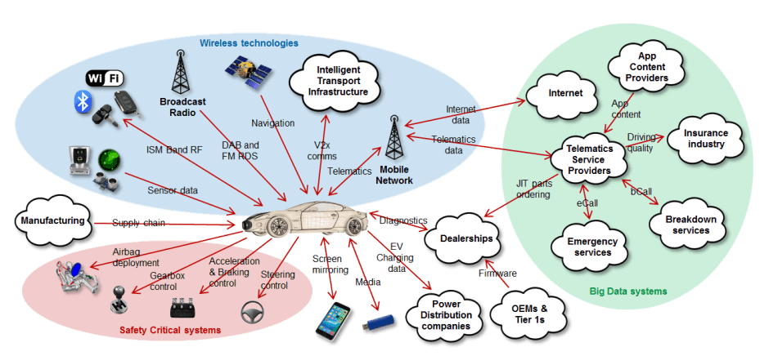

Commercial Vehicle vs Passenger Car

Slide 5
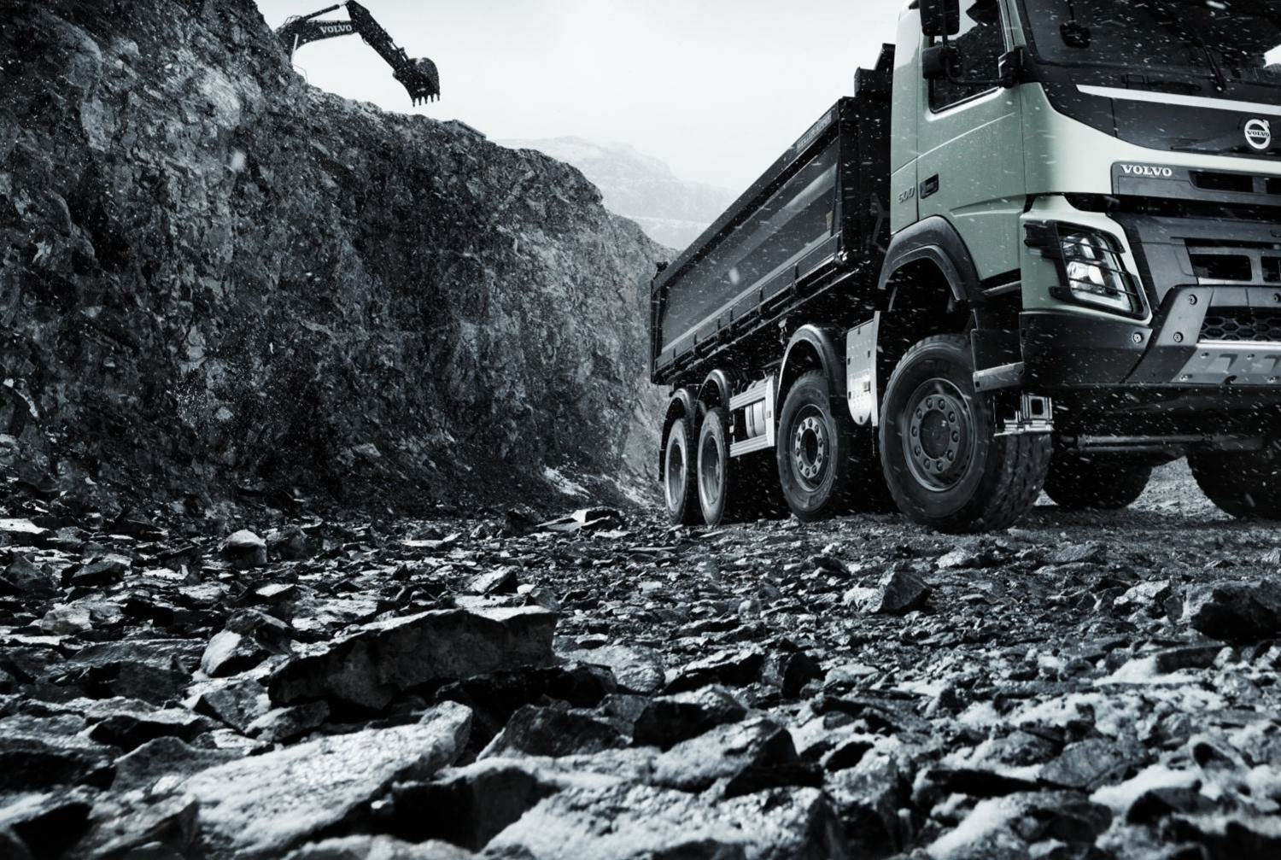
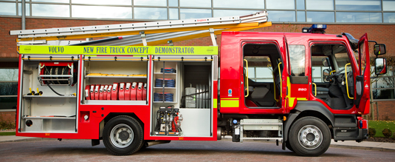
Commercial Vehicle vs Passenger Car
DESIGNED TO BE CUSTOMIZABLE
Bodybuilder interface used to build trucks for purpose X
Diversified attack surfaces to consider during design
Notes:
Customization: Customizable and tuned to buyers business, distances of transportation, weight, types of roads. Hardly two trucks produced are the same. Different parameters.
Body builders are able to interface and control parts of the functionality, engine revs, power take-off.
Easier to fix a car configuration in the factory.

Slide 6
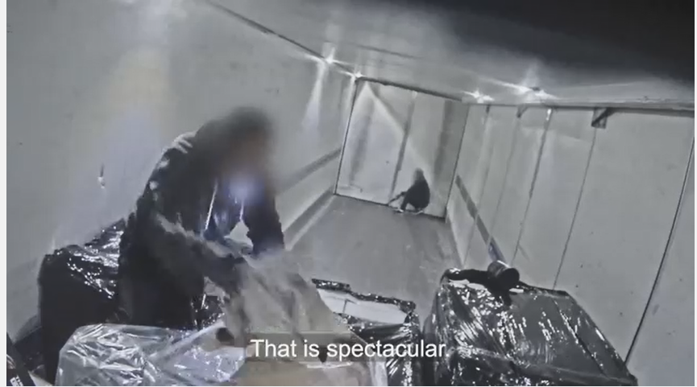
https://www.youtube.com/watch?v=wUGZ6Fiov2I

Slide 7
Commercial Vehicle vs Passenger Car
THEFT OF TRANSPORTED MATERIAL VS VEHICLE ITSELF
AVAILABILITY OF TRANSPORTED MATERIAL SOMETIMES CRITICAL
“Over 80 percent of all communities in the US rely exclusively on trucks to deliver all of their fuel, clothing, medicine, and other consumer goods”
Source: https://en.wikipedia.org/wiki/Trucking_industry_in_the_United_States

Slide 8
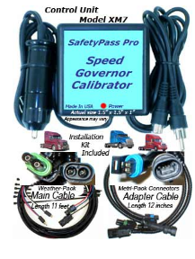
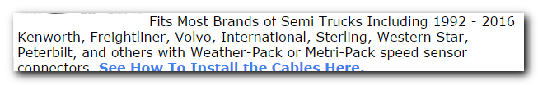
Commercial Vehicle vs Passenger Car
DIFFERENT LEGISLATION
  90km/h speed limit in the EU
  emissions
  driver resting hours
Source: http://fastertruck.com

Slide 9

Commercial Vehicle vs Passenger Car
SOLD TO BUSINESSES, NOT PERSONS
DRIVER AND OWNER OFTEN DIFFER
fleet of trucks (compare taxi services, car pools)
Notes:
Driver & Owner: Creates misuse cases there in between. e.g. using truck to run other errands. Good driving bonus programme (speeding) . Owner business image impacted on bad driving. Compare teenager borrowing a car.
Future ~ transportation as service, extrapolate car pool and uber. Will people be owner of their own car?

Slide 10


Slide 11
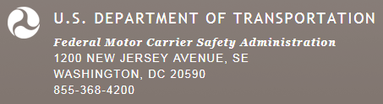
Introduction to ELD Mandate
US-DOT Federal Motor Carrier Safety Administration (FMCSA) published the final electronic logging device rule — or ELD mandate – in Dec. 2015
  requires an electronic logging device (ELD) to be used by commercial drivers who are required to prepare hours-of-service (HOS) records of duty status (RODS).
Fleets have until December 2017 to implement certified ELDs in commercial vehicles (enforced for vehicles model year 2000 and newer), i.e. applies also for existing vehicles on the road
ELD device manufacturers performs self-certification.
i.e. leaves a lot of room for ambiguity, and unknown implementations

Slide 12
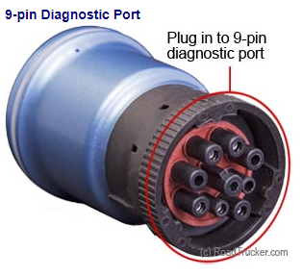
ELD and Cybersecurity
CAN and Wireless access
An ELD shall automatically record: date; time; location; engine hours; vehicle miles and identification information for the driver.
An ELD must be “integrally synchronized with the engine" of the vehicle. Engine synchronization means monitoring of the vehicle’s engine to automatically capture the engine’s power status, vehicle’s motion status, miles driven, and engine hours.
      An ELD will have CAN bus access (read/send)
A compliant ELD must provide one of the following data transfer options:
Option 1: Telematics: Web Services and Email
Option 2: Local Transfer: USB 2.0 and Bluetooth
      An ELD will have wireless access

Slide 13
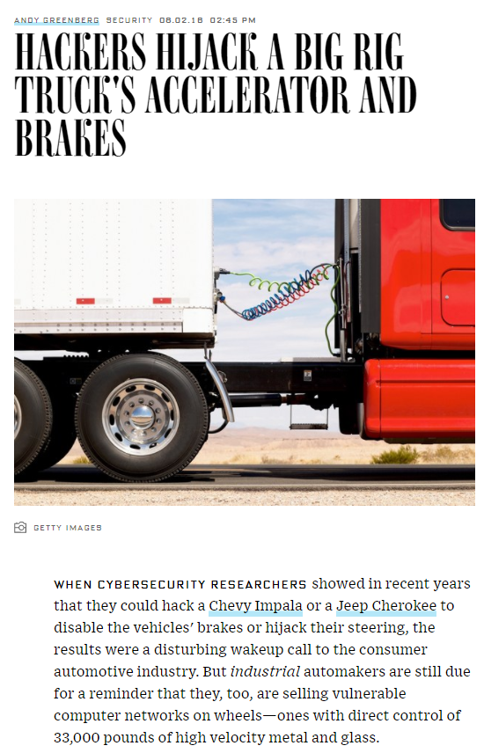
Impact (in existing vehicles)
ELD devices will connect to J1939 network to get required information
J1939 protocol is standardized and publicly available, also for critical vehicle control signals (e.g.,Torque Speed Control).
ELD devices will have capability to read and send CAN frames (in order to support multiple vehicle OEMs, and since some data only available by request according to standard)
Researchers show J1939 standardized signals can be used to control vehicle from OBD.
ELD adds wireless attacks, in case ELD compromised.

Slide 14
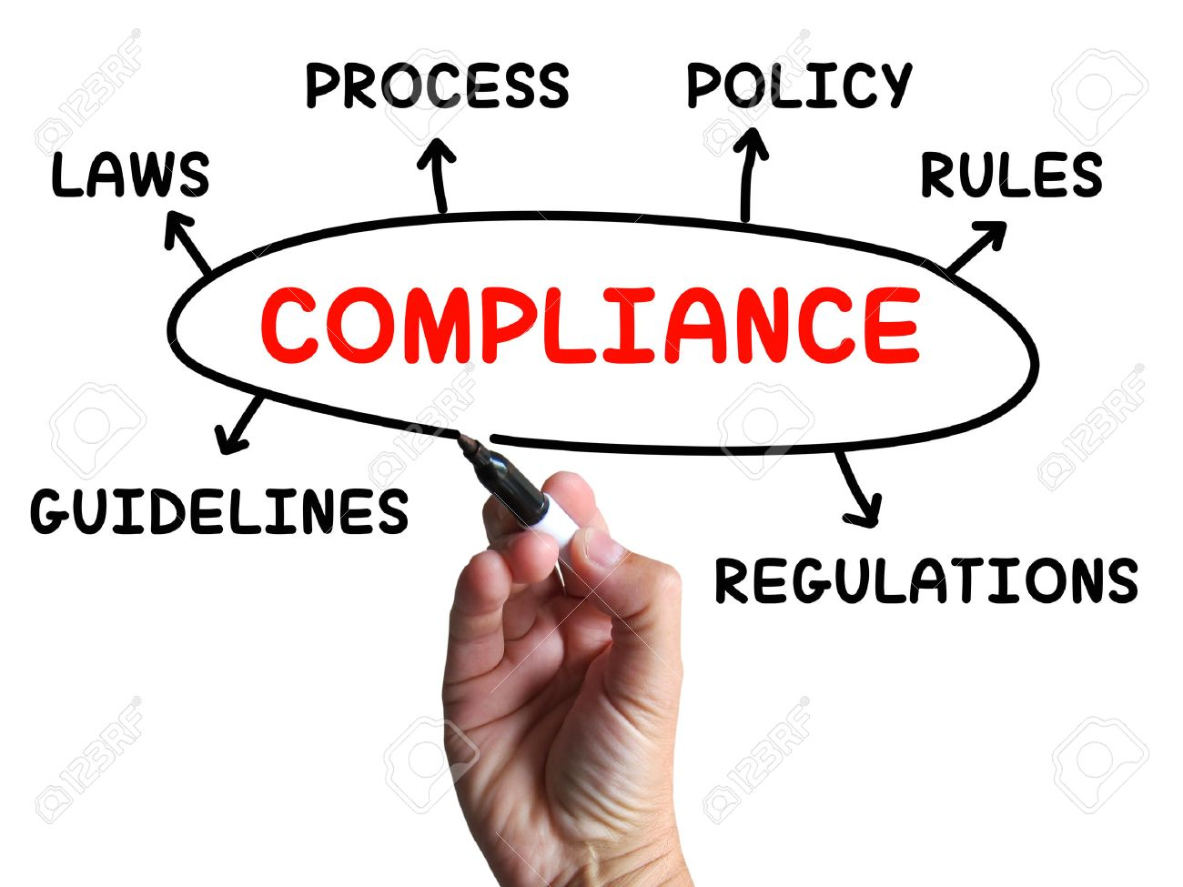


Slide 15

EU: ENISA Guidance, February 2017
European Union Agency For Network And Information Security
“Cybersecurity and Resilience of smart cars”
Good practices and recommendations (DOI: 10.2824/87614)
covers passenger cars and commercial vehicles including trucks but excluding autonomous vehicles.
lists sensitivities present in smart cars as well as corresponding threats, risks, mitigation factors and possible security measures that can be taken.
applies to car manufacturers, Tier 1 and Tier 2 suppliers, aftermarket suppliers, insurance providers and other auto industry stakeholders.
industry needs to make efforts to clarify where liability may fall amongst car manufacturers, tier suppliers, vendors, aftermarket support operators and end users.

Slide 16
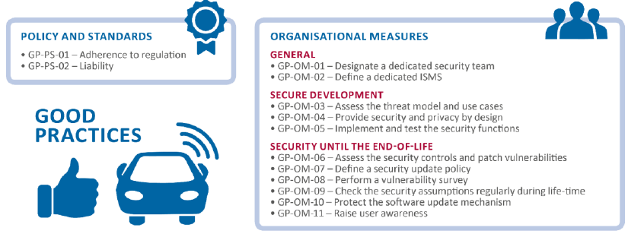
EU: ENISA Guidance, February 2017
“Cybersecurity and Resilience of smart cars”

Slide 17
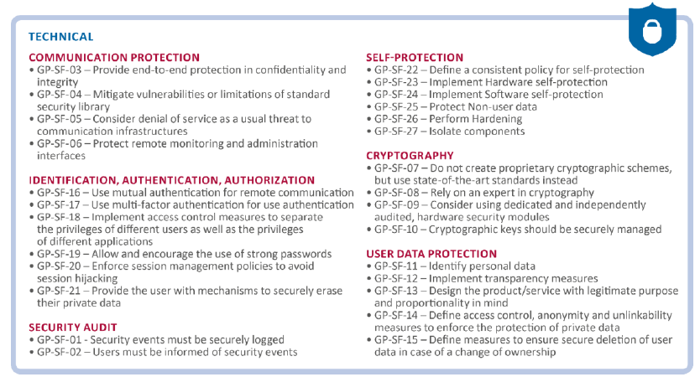
EU: ENISA Guidance, February 2017
“Cybersecurity and Resilience of smart cars”

Slide 18
Nov 27, 2017: Draft Recommendation on Cyber Security of the Task Force on Cyber Security and Over-the-air issues of UNECE WP.29 IWG ITS/AD
Informal Working Group on Intelligent Transport Systems / Automated Driving (IWG on ITS/AD)
Defines principles to address key cyber threats and vulnerabilities identified in order to assure vehicle safety in case of cyber-attacks.
Defines detailed guidance or measures for how to meet these principles, including examples of processes and technical approaches.
Considers what assessments/evidence may be required to demonstrate compliance/certification with any requirements identified.
https://www.unece.org/fileadmin/DAM/trans/doc/2017/wp29grrf/GRRF-84-31e.pdf

Slide 19


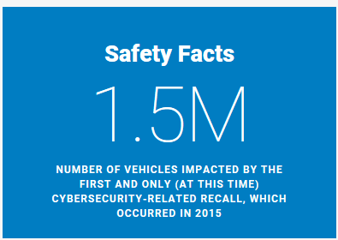
October 2016: Cybersecurity Best Practices for Modern Vehicles
  National Highway Traffic Safety Administration. (2016, October). Cybersecurity best practices for modern vehicles. (Report No. DOT HS 812 333). Washington, DC: Author.
Covers cybersecurity issues for all motor vehicles and therefore applicable to all individuals and organizations manufacturing and designing vehicle systems and software.
  entities include, but are not limited to, motor vehicle and motor vehicle equipment designers, suppliers, manufacturers, alterers, and modifiers

Slide 20
September 2017: Automated Driving Systems 2.0: A Vision for Safety
Focuses on vehicles that incorporate SAE Automation Levels 3 through 5 – Automated Driving Systems (ADSs).
Applies to the design aspects of motor vehicles and motor vehicle equipment under NHTSA’s jurisdiction, including low-speed vehicles, motorcycles, passenger vehicles, medium-duty vehicles, and heavy-duty CMVs such as large trucks and buses.
Outlines 12 safety elements that are generally considered to be the most salient design aspects to consider and address when developing, testing, and deploying ADSs on public roadways.
  7. Vehicle Cybersecurity: Entities are encouraged to follow a robust product development process based on a systems engineering approach to minimize risks to safety, including those due to cybersecurity threats and vulnerabilities.
https://www.nhtsa.gov/sites/nhtsa.dot.gov/files/documents/13069a-ads2.0_090617_v9a_tag.pdf

Slide 21
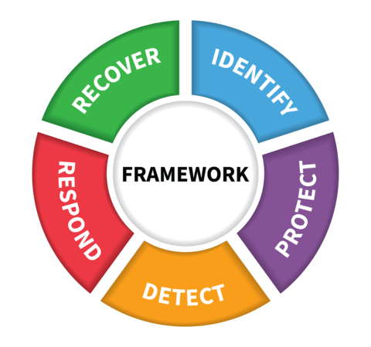

NIST Cybersecurity Framework (CSF)
Source: https://www.nist.gov/cyberframework
Version 1.1 Draft 2, December 2017
This voluntary Framework consists of standards, guidelines, and best practices to manage cybersecurity-related risk.

Slide 22
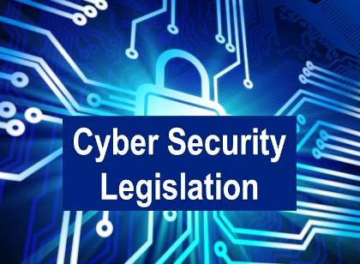
Proposed
USA: Internet of Things Cybersecurity Improvement (IoTCI), 2017
  “Requires all IoT devices purchased by the government to be compliant with the NIST Best Practices framework”
USA: Security and Privacy in Your Car Study Act of 2017 (SPY Car Act)
USA: SELF DRIVE and AV START Acts, 2017
  Aim at clearing regulatory hurdles for the deployment of autonomous vehicles
  Include specific sections with respect to cybersecurity
http://2o9ub0417chl2lg6m43em6psi2i.wpengine.netdna-cdn.com/wp-content/uploads/2017/11/118.pdf

Slide 23



SAE J3061 ”Cybersecurity guidebook for Cyber-Physical Vehicle Systems” released Jan 2016.
ISO 21434 – “Road vehicles - Cybersecurity engineering”
ISO 15764 - Secure data link for diagnostic

Slide 24



Many guidelines, best practices, recommendations, etc.!!!
Establishing ”right” balance? ”much”/”less”/”adequate”?
What is ”unique”/”different” across those?
Any major ”surprise” across those? ”missing”?
How/What to follow and follow-up of .....?
How to
adapt to the needs of each ”stakeholder”?
keep pace with ”dynamic” nature of cybersecurity?
learn from other industries that are ”good” in security?
align automotive safety and security processes?
    Utilize existing safety knowledge & experience!

Slide 25

